Slide 1
Telenet Business Mobile
Introduction to Online Tools for Fleet Users

Slide 2
My Telenet & Telenet App
Step-by-step instructions for Fleet Users

Slide 3
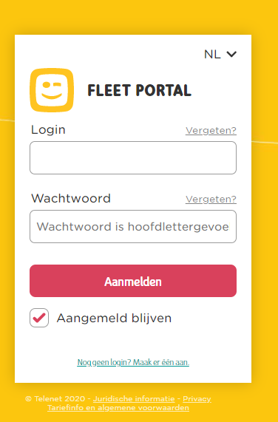
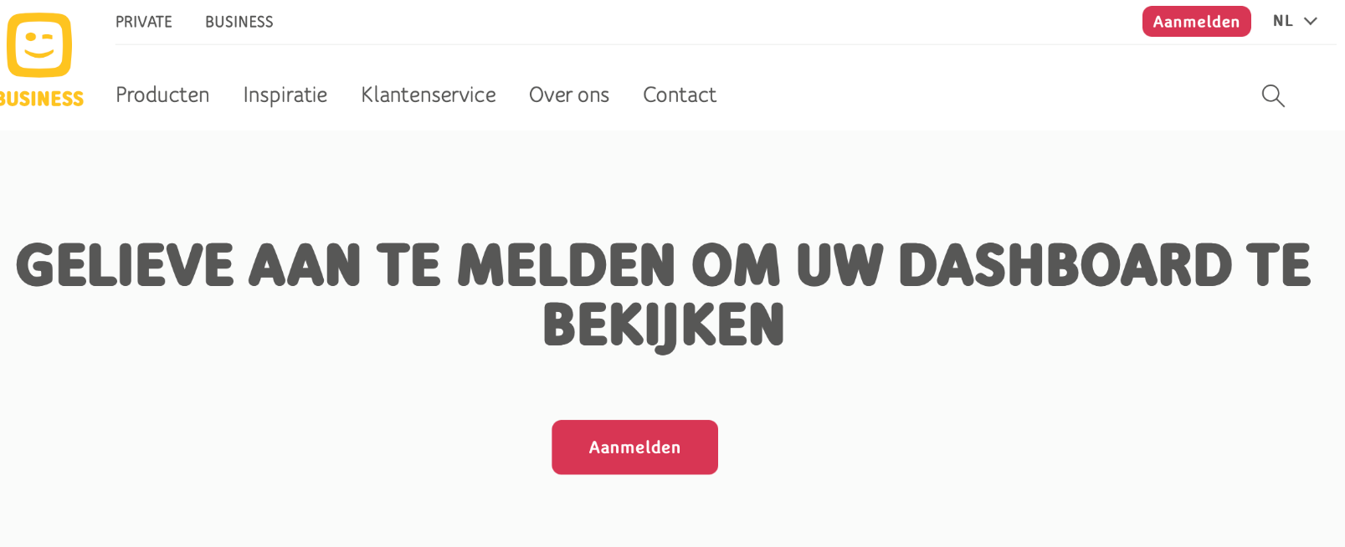
How to logon to the My Telenet Zone ?
All fleet users need to self register to create a logon
Go to : https://www2.telenet.be/business/nl/klantenservice/ucc/gebruiker
Press ‘Aanmelden’
Press ‘nog geen Login? Maak er één aan’

Slide 4
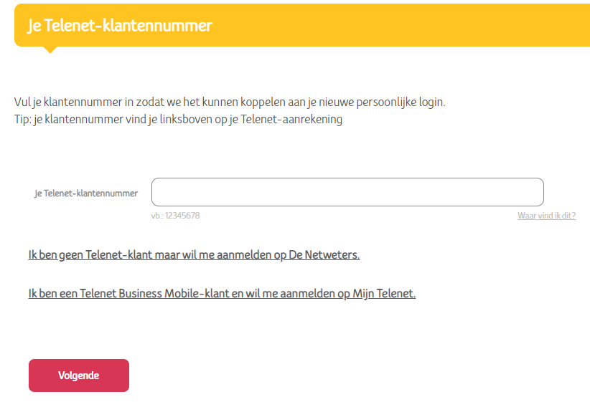
Fleet user self registration
Choose the link for TB Mobile customers

Slide 5
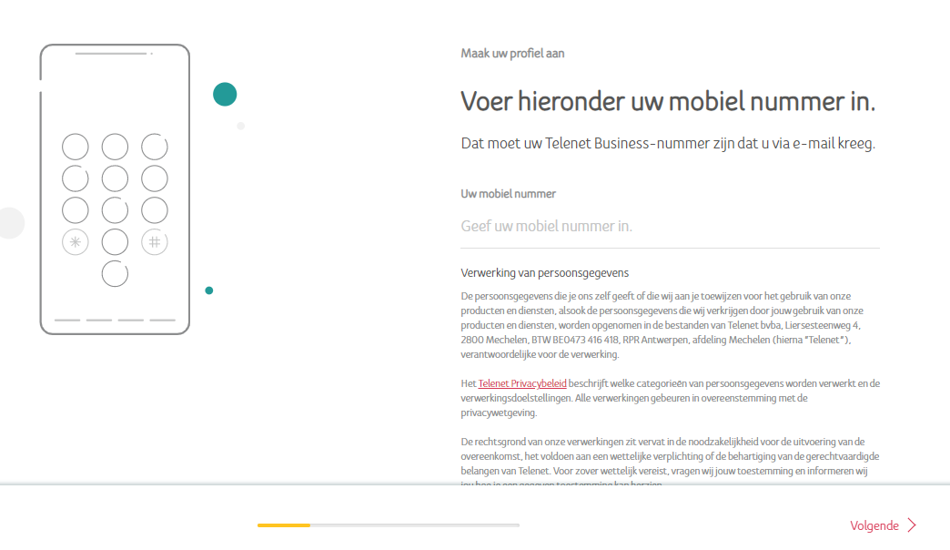
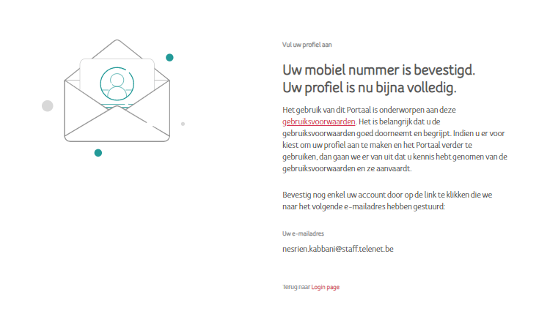
Fleet user self registration
Fill in mobile number and follow the steps via ‘Volgende’ link – until mobile number is confirmed

Slide 6
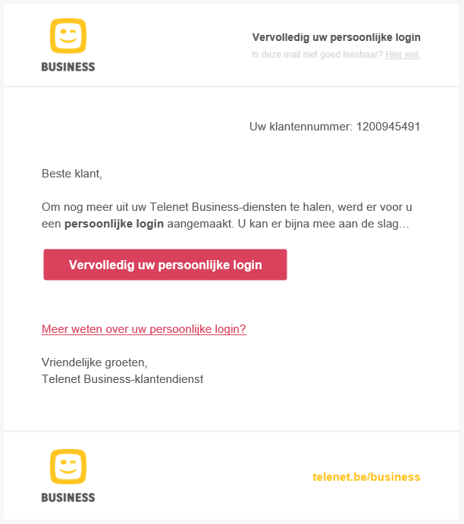
Fleet user self registration
Confirm the link in the email to complete your personal login

Slide 7
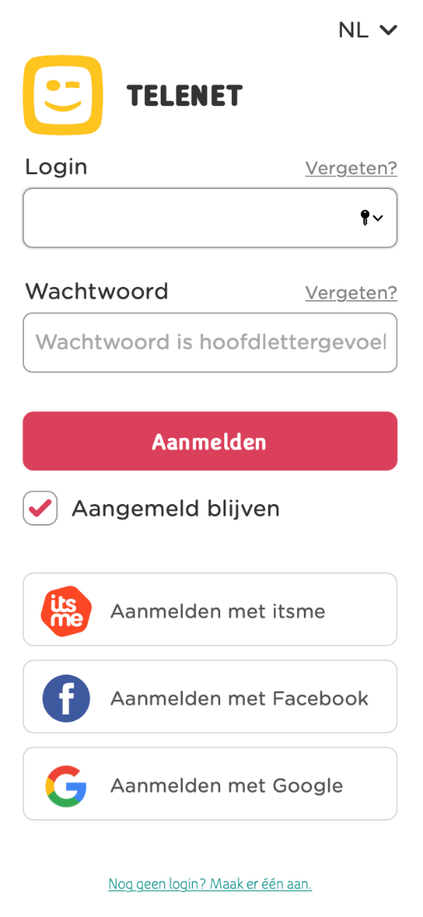
How to logon to the My Telenet Zone ?
https://www2.telenet.be/business/nl/klantenservice/ucc/gebruiker
After fleet user registration, navigate to the My Telenet url
Enter your user credentials
Press ‘Aanmelden’

Slide 8
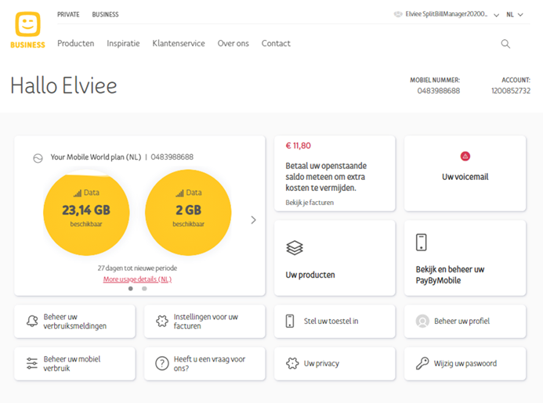
How to logon to the My Telenet Zone ?
https://www2.telenet.be/business/nl/klantenservice/ucc/gebruiker
The My Telenet dashboard loads after successful logon

Slide 9
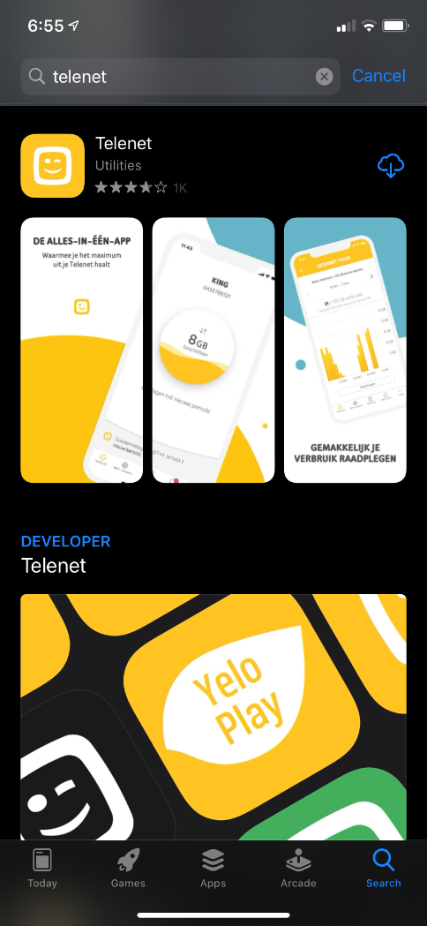
How to Set up the Telenet App ?
After fleet user registration, open the app store of your mobile device
Search for Telenet
Select and install Telenet App

Slide 10
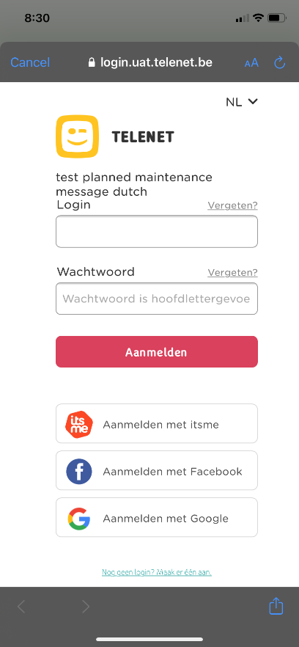
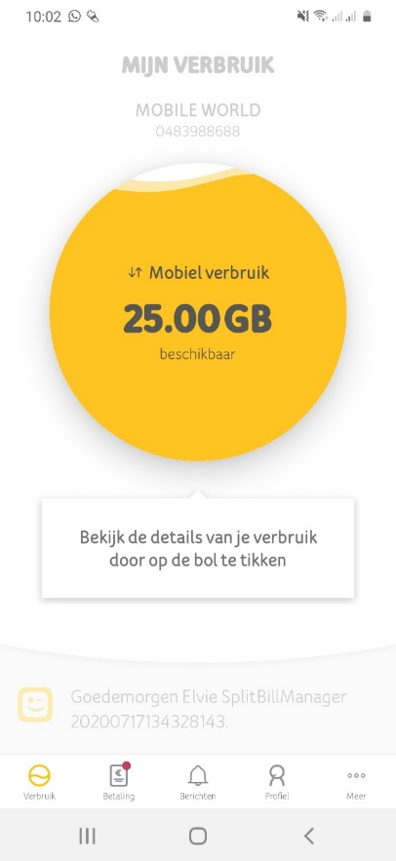
How to Set up the Telenet App ?
Open the Telenet App
Click on ‘Meld je aan’
Enter your credentials
Click ‘Aanmelden’

Slide 11
My Telenet & Telenet App Features
Consult Usage
Consult Products
Invoice Overview & Payments
Manage User Profile

Slide 12
Back to overview
Consult Usage

Slide 13
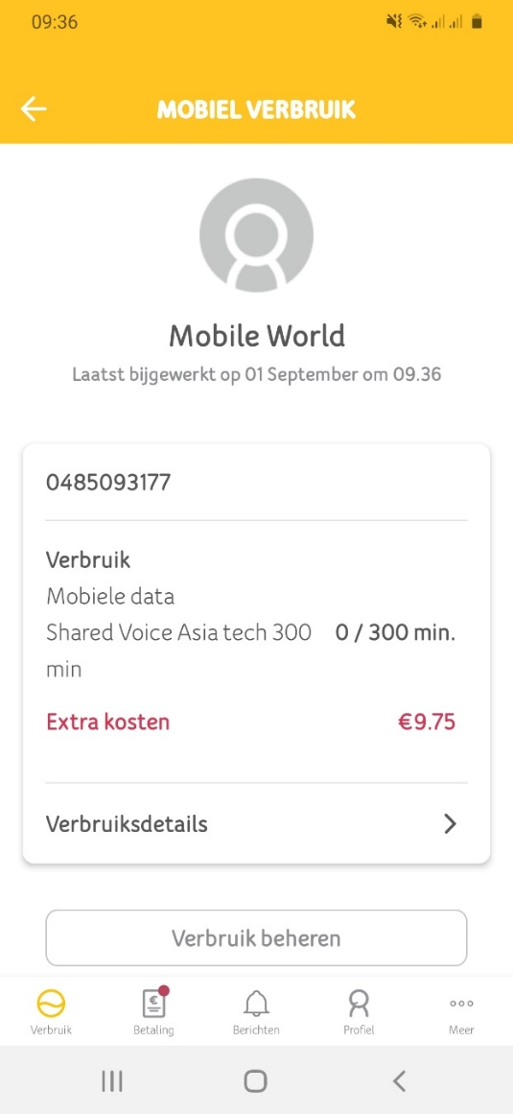
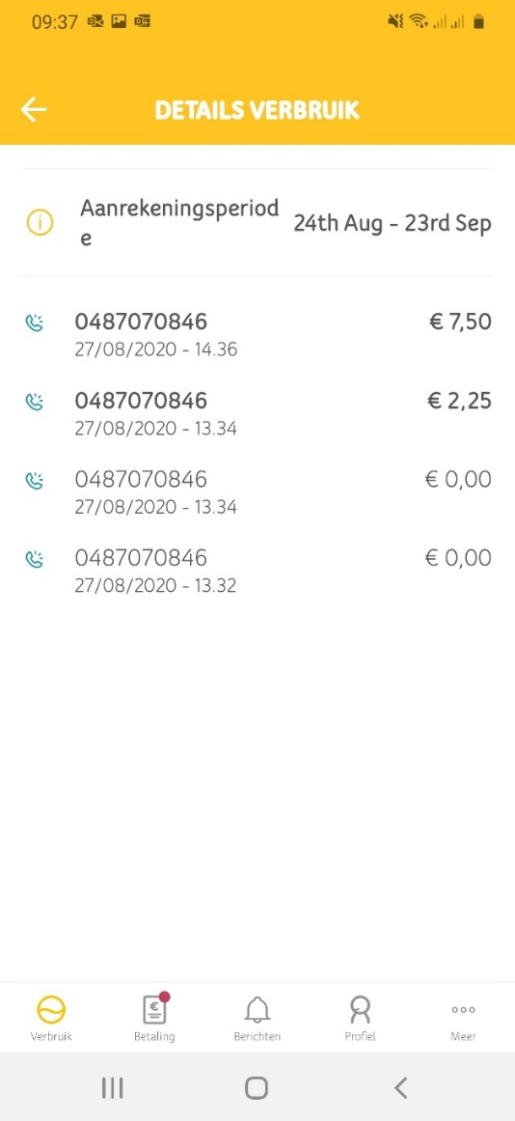
Consult Usage - Telenet App
Back to overview
Press the “Mobiel Verbruik” circle
Select ‘Verbruiksdetails’

Slide 14
Consult Usage - My Telenet
Back to overview
Click on the “Mobile Vebruik” tegel

Slide 15
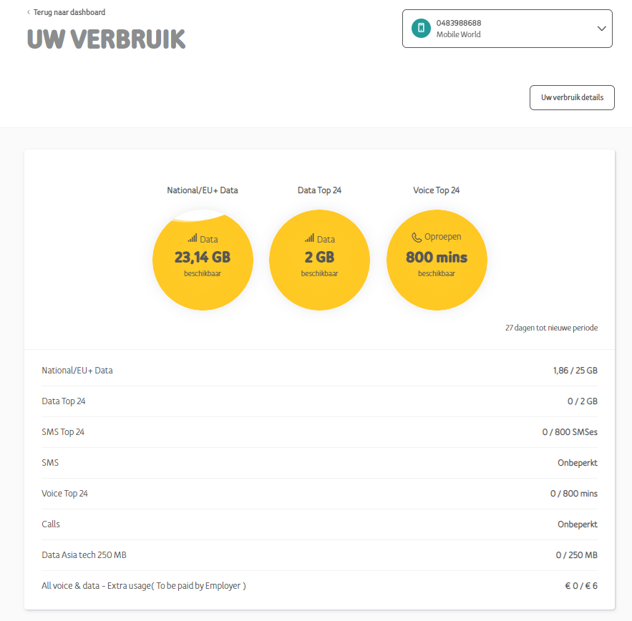
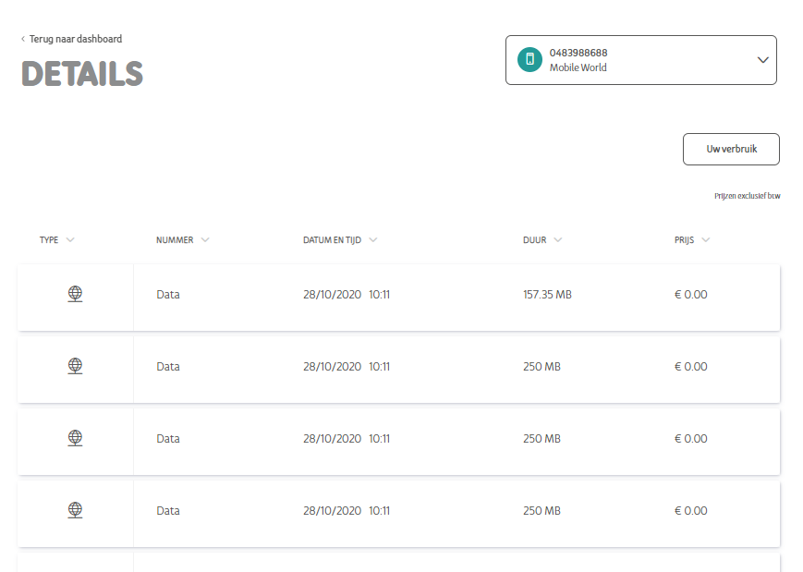
Consult Usage - My Telenet
Back to overview
Select ‘Uw verbruik details’

Slide 16
Back to overview
Consult PRoducts

Slide 17
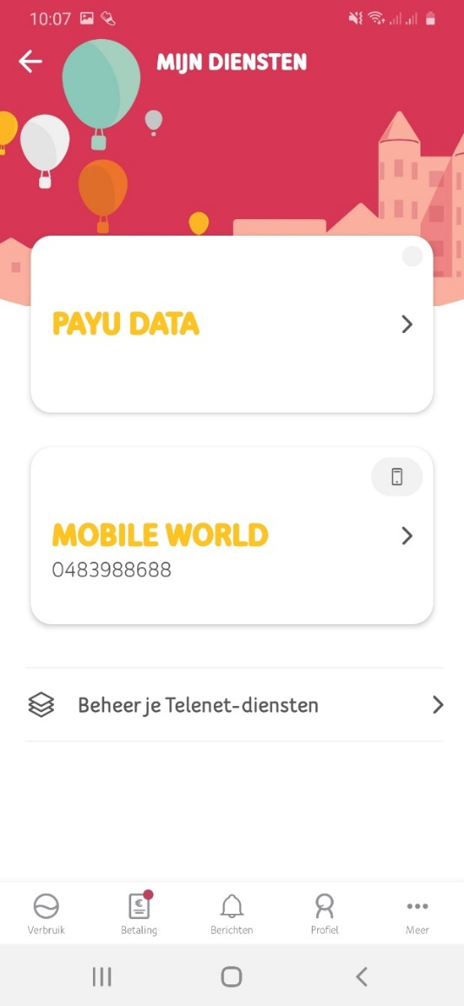
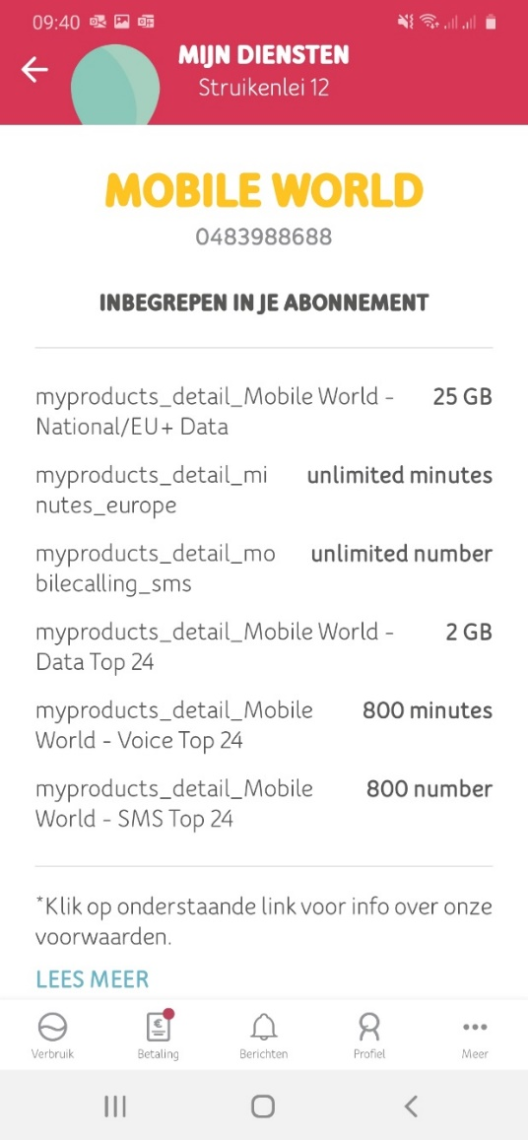
Consult Products – Telenet App
Back to overview
Click on ‘Meer’
Select ‘Mijn diensten’
Click on ‘Beheer je Telenet-diensten’

Slide 18
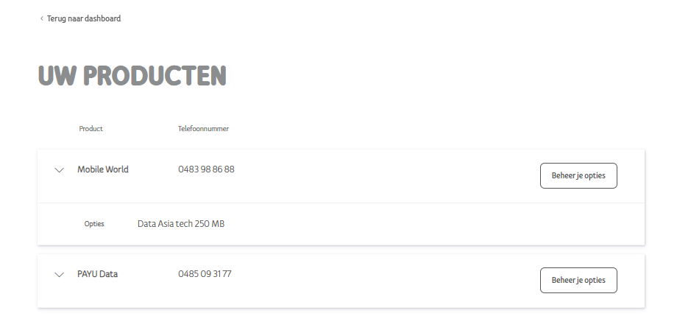
Consult Products – My Telenet
Back to overview
Select ‘Uw producten’
You can manage options via ‘Beheer je opties’

Slide 19
Back to overview
Invoices & Payments

Slide 20
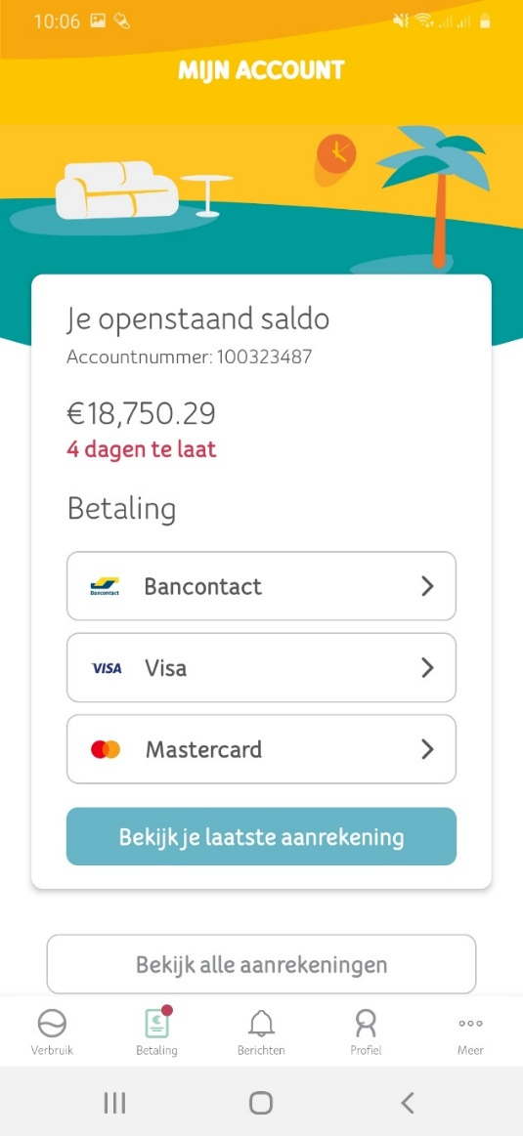
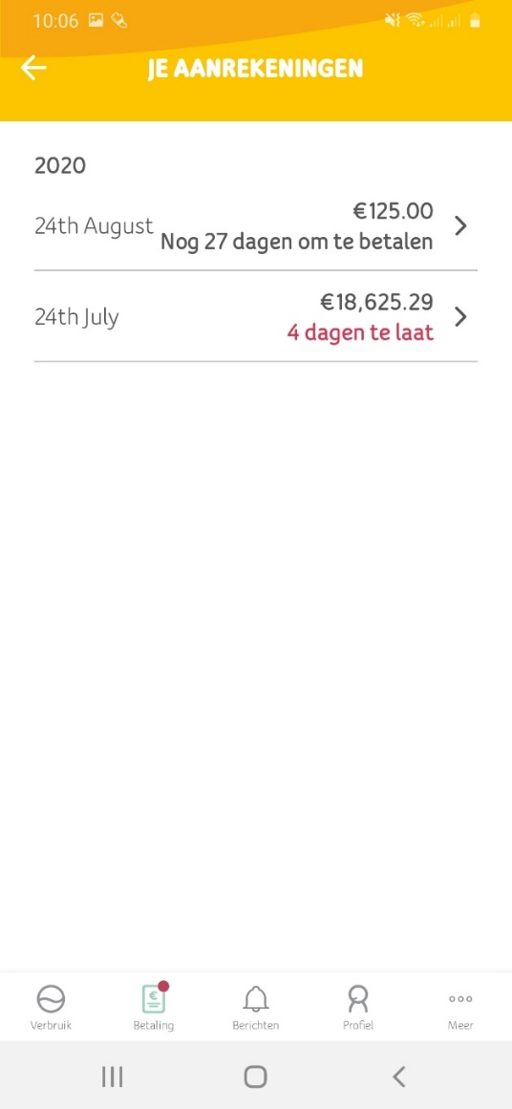
Consult Invoices & Payments – Telenet App
Back to overview
Click on ‘Betaling’
Click on ‘Bekijk alle aanrekeningen’
or ‘Bekijk je laatste aanrekening’

Slide 21
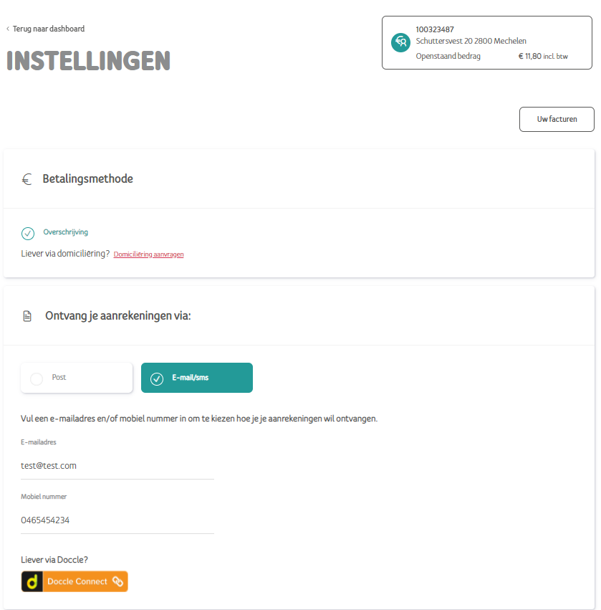
Invoices & Payments – My Telenet
Back to overview
Select ‘Instellingen voor uw facturen’
You can change the invoice setting

Slide 22
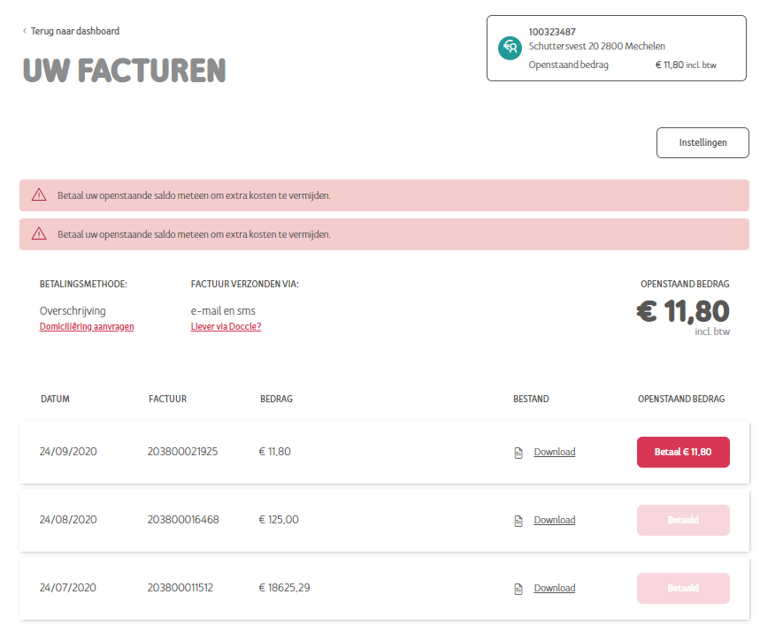
Invoices & Payments – My Telenet
Back to overview
Select ‘Uw facturen’
You can download your invoice and pay online

Slide 23
Back to overview
Manage User Profile

Slide 24
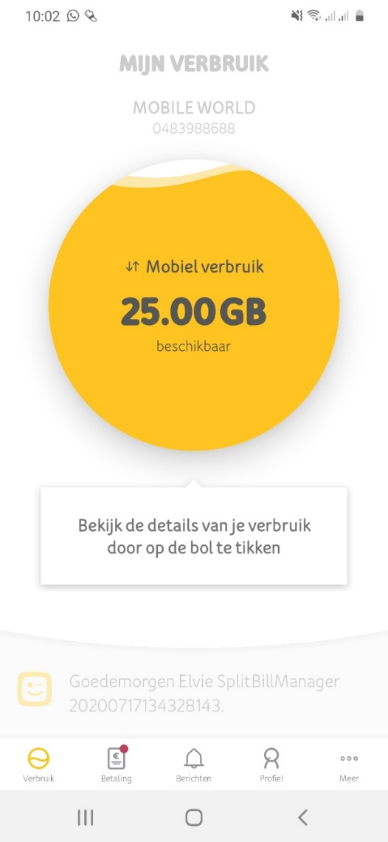
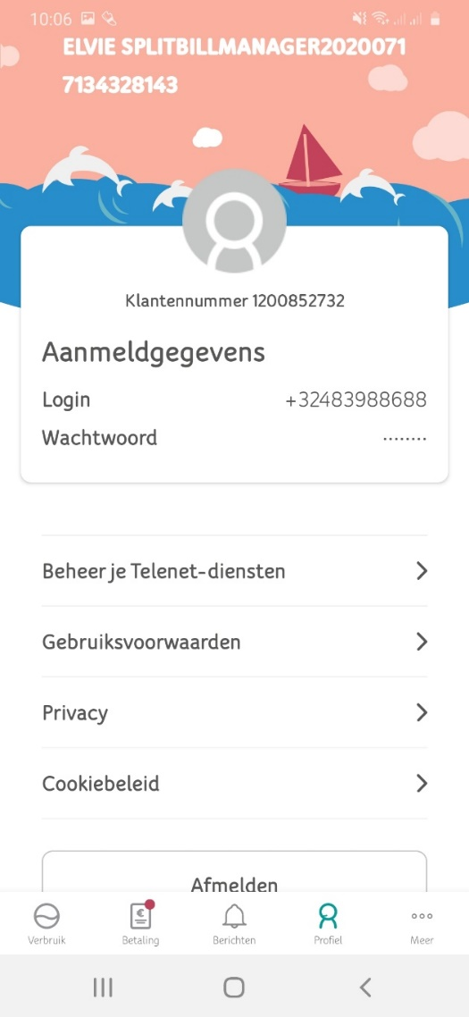
Manage User Profile – Telenet App
Back to overview
Click on ‘Profiel’

Slide 25
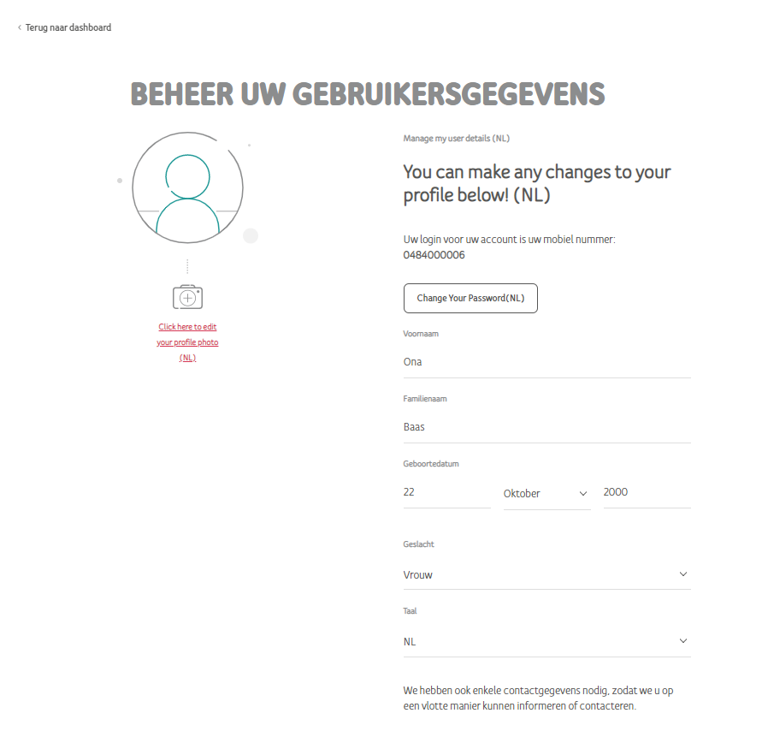
Manage User Profile – My Telenet
Back to overview
Select ‘Beheer uw profiel’
You can change your profile setting

